Slide 1
Wireless Connection

Slide 2
Outcomes
To experiment with wireless connectivity for microcontrollers.
Setting up the IDE for a wireless uC.
Connecting to the WiFi.
Accessing the internet.

Slide 3
ESP32 & ESP8266
Low cost microcontrollers with built in WiFi and TCP/IP. (Espressif Systems, China, 2014)
Extremely popular for wireless projects.
ESP8266 is earlier implementation.
ESP32 is the successor to ESP8266. More powerful microcontroller. Usually includes Bluetooth.

Slide 4
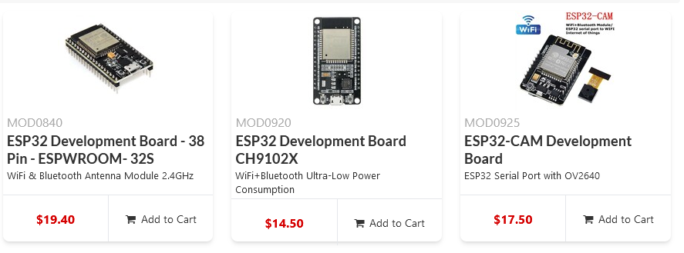
As of May 2025. ESP8266 boards are generally cheaper!

Slide 5
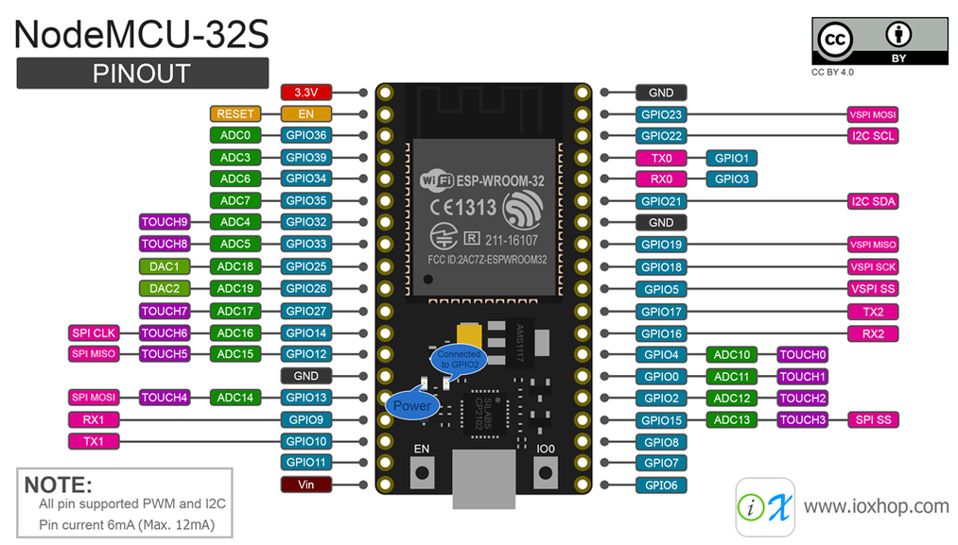

Slide 6
Bells & Whistles!
ESP devices are a little bit bare bones. Some of the nice features we are used to are not implemented easily.
This can depend on the platform/form factor of the device, eg: analogue input/outputs
Logic levels will be different too – typically 3.3 volts!
Check requirements on sensors
You might need to use a bi-directional logic level converter

Slide 7
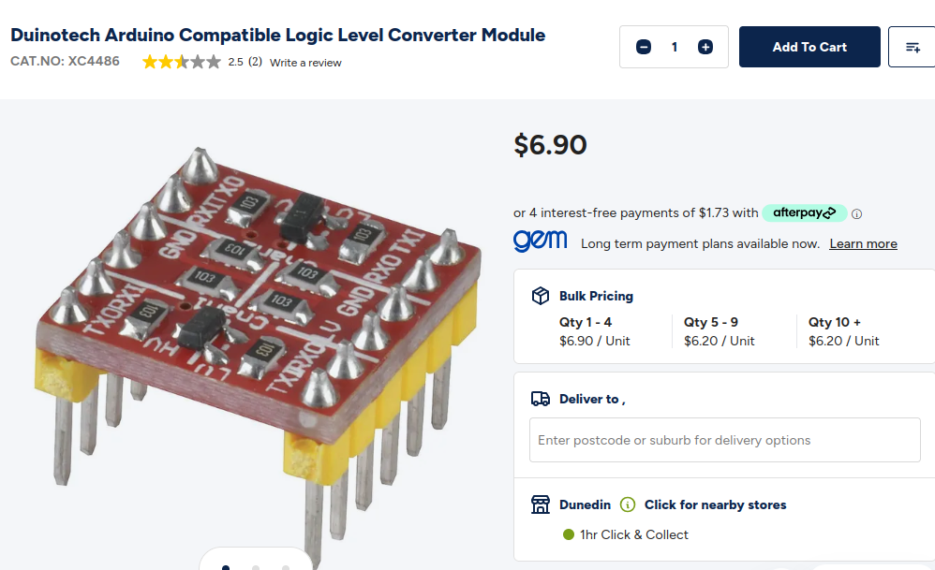

Slide 8
Digital IO
The PinMode() method works on the GPIO pin number for esp32 and esp8266.
GPIO5?
PinMode(5, INPUT)
Remember pull up and pull down resistors. Some devices do allow:
(PinMode pin_no, INPUT_PULLUP)

Slide 9
Analogue IO
Depends very much on the board layout you are using!
Some board will have dedicated Analogue pins
Pulse Width Modulation can be used for analogue output.

Slide 10
Other Features
I2C
Interupts
Most Arduino C software features will be supported if the device is supported by the IDE.

Slide 11
Setting up the IDE.
ESP devices are not Atmel devices (The default uC for Arduino platform)
We usually have to:
Update the URL for additional boards in Preferences
Use the Boards Manager to change our default board.

Slide 12
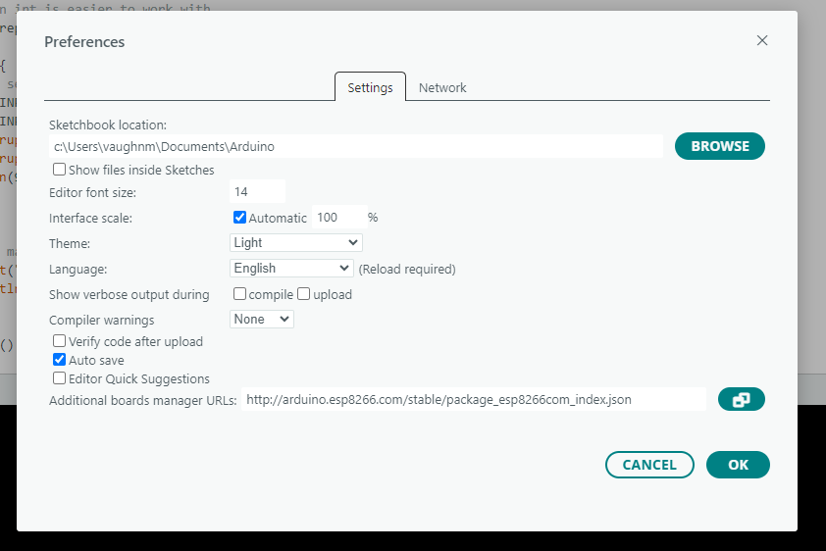

Slide 13
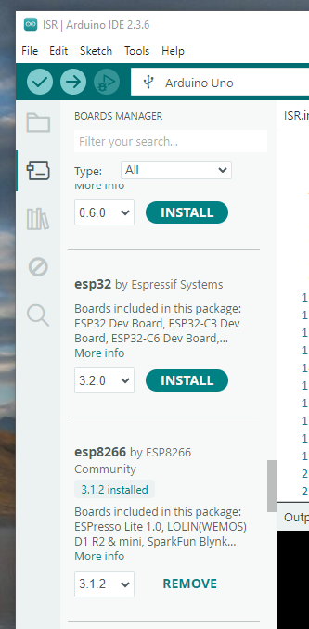

Slide 14
Connecting to WiFi
We have a router in D312 we can use to experiment with:
SSID - D_Block_Lab
Pass - P@ssw0rd

Slide 15
Accessing the Internet.
We have a couple of supplied Sketches for connecting your device to the wifi.
Can you retrieve the contents of a webpage with it?
You will need to do some digging around!
Try and access:
info.cern.ch

